Slide 1
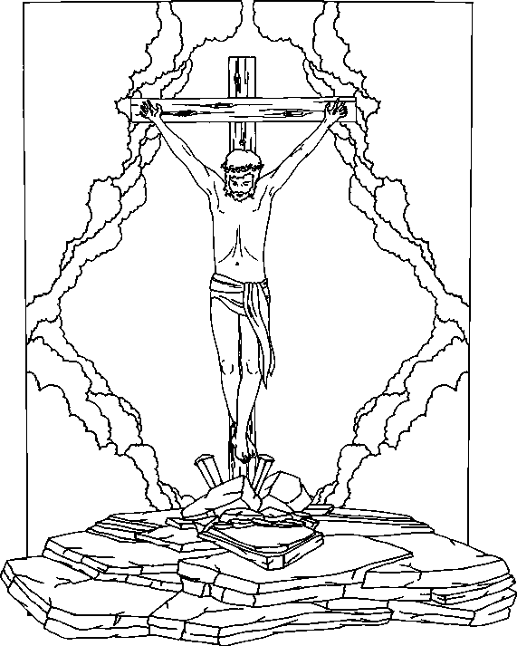
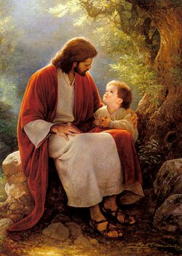
Jesus Christ the Sacrifice
^{(Ps 27:1)} “The Lord is my light and my Salvation”

Slide 2
Beginning of the story;…

Slide 3
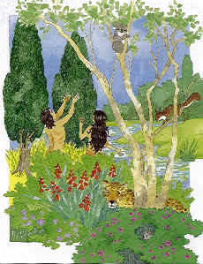
Why the Sacrifice?
^{(Gen 3:8)} “And they heard the sound of the LORD God walking in the garden in the cool of the day and Adam and his wife hid themselves from the presence of the Lord GOD among the tress of the garden”
St Athanasius book (Incarnation of the Word)

Slide 4
God is eternal, everything He does is eternal
^{(Ecc 3:14)} “I know that whatever God does, It shall be forever”
We just need to believe and work

Slide 5
Our focus is on the sacrifice alone:
^{(Acts 4:12)} Nor is there
salvation in any
other, for there is no
other name under
heaven given among
men by which we
must be saved.”
Liturgy of St Gregory
(Prayer of reconciliation) Neither an angel nor an archangel neither a patriarch nor a prophet have You entrusted with our salvation.

Slide 6
The series:
Jesus the veil
Jesus the teacher
Jesus the Sacrifice
Jesus the Lamb

Slide 7
The Liturgy:
Offering of incense (Evening & Morning)
Doctrinal Liturgy (Catechumens)
Liturgy of the Faithful (Believers)

Slide 8
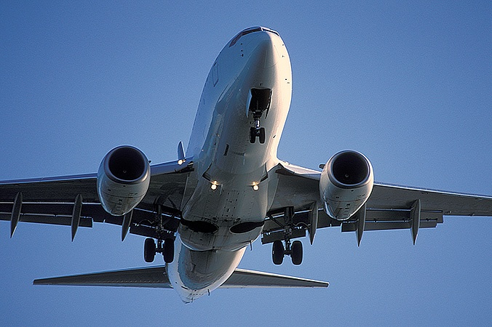
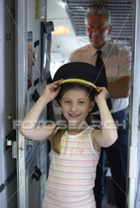
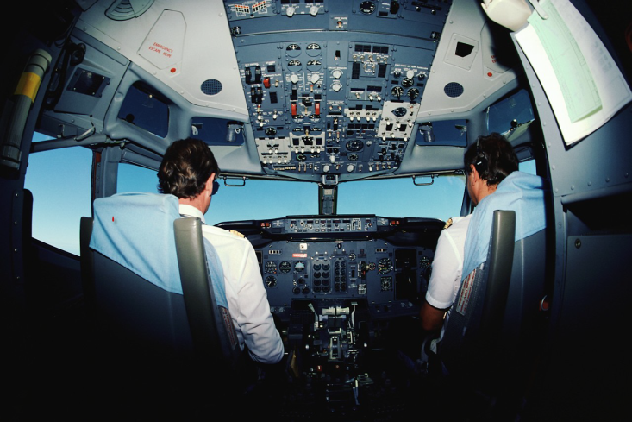

Slide 9
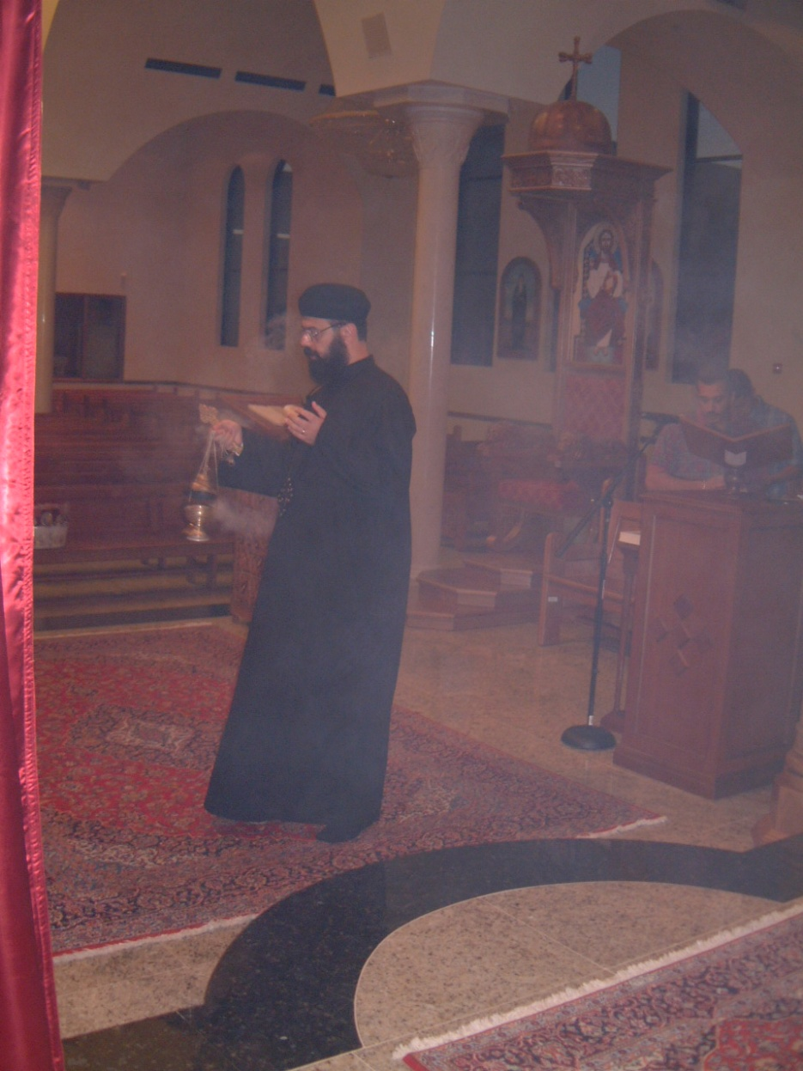
Do we offer a
sacrifice in the
Offering of Incense
(Evening and
Morning)?

Slide 10
Is there a relation between the sacrifice and incense?
In the offering of incense (Morning) Abuna
prays inaudibly:
“O God who received to Yourself the offerings of the righteous Abel, the sacrifice of Noah and Abraham and the incense of Aaron and Zachariah”

Slide 11
In the Jewish Rite there was a prayer at
morning & evening where they used to offer a sacrifice.
In the New Testament, we have ONLY one sacrifice.
This was changed to Offering of incense
morning & evening.

Slide 12
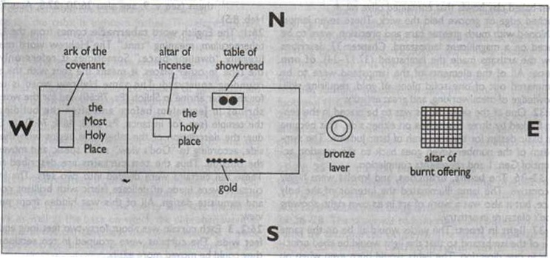
In the OT the Lord asked to build an alter of incense in the Holy

Slide 13
In the morning if you attend raising of
incense and leave to work.
As if you have offered a sacrifice.
Not an animal sacrifice or Body and Blood
but a sacrifice of incense.

Slide 14
Offering of Incense:
^{(Malachi 1:11)} My name will be great among the nations, from the rising to the setting of the sun. In every place incense and pure offerings will be brought to my name
This is a prophecy about the NT
In the OT Jews were not allowed to offer a
sacrifice of incense except in the alter or the
Tabernacle.
In the NT raising of incense is offered in all
churches around the world.

Slide 15
In the Doctrinal Liturgy
(Selection of the Lamb)
After choosing the lamb, the priest touches the other breads in the basket with the back of the chosen bread which is still in his right hand.
* Symbol that all sacrifices of the OT pointed to the Sacrifice of the Cross.
While still in his right hand, he then wipes the chosen bread carefully with the small veil, taking care not to turn it upside down and always keeping it at the top.
* Symbol of the superior honor and glory that the Sacrifice of the NT has over those of the OT.

Slide 16
In the Doctrinal Liturgy
(Baptizing the lamb)
While choosing the lamb, the priest wets his right index finger with the wine (Blood) and makes the sign of the cross on the bread
Symbol of the baptism of Christ by St John in the River Jordan.
While doing this he says:
(Let our sacrifice be accepted before You Lord for the forgiveness of my sins…. ).
We’re focused on Jesus Christ the Sacrifice at every moment in the Liturgy.
Here the priest places the burdens of himself, his congregation, the Church and the whole world on the sacrifice.

Slide 17
The Creed
Before offering the bloodless offering and receiving communion:
1. Faith
^{(Heb 11:1)} Now faith is the substance of things hoped for, the evidence of things not seen.
2. Love (end of the Prayer of Reconciliation)
“Greet one another with a holy kiss...”
3. Hope:
We announce our hope in the Resurrection of the dead when Christ will come again with all the happiness and joy for those who are righteous.
^{(1Corth 13:13)} And now abide faith, hope, love.

Slide 18
Prayer of Reconciliation
Abuna starts by “O God the Great, the eternal, who formed man in incorruption; and death which entered into the world through the envy of the devil you have destroyed by the life giving manifestation of Your only-begotten Son, our Lord God and savior Jesus Christ…….”
During Holy Week, the Reconciliation prayer is not prayed on Monday to Thursday as an indication that the true reconciliation will not be accomplished until the crucifixion of Christ on Friday.

Slide 19
Prayer of Reconciliation ^{(2nd part)}
Abuna prays “According to Your good will O God fill our hearts with Your peace…..”
^{(John 14:27)} Peace I leave with you, My peace I give to you; not as the world gives do I give to you. Let not your heart be troubled, neither let it be afraid.

Slide 20
Prayer of Reconciliation ^{(end)}
Phase of Jesus Christ the Sacrifice begins.
Abuna & the Deacon raise the Eprospherin as a symbol of the angel removing the stone from the tomb of the Lord.
End of the phase of Jesus the teacher .
Deacon puts the Gospel behind the Chalise.

Slide 21
The Institution Narrative (Incensing the hands):
Abuna points to the bread and wine with his hands which are covered with the veils and says “He instituted this great Mystery of godliness …”.
He puts the veils on both sides of the Throne then incenses his hands over the censor.
In preparation to touch , consecrate, fragment and distribute the Holy Sacraments.

Slide 22
The Institution Narrative :
Abuna prays:
“He looked up toward heaven to You, O God, who are His Father and Master of everyone.”
“And when He had given thanks.. He blessed it… He sanctified it…”
People: Amen we believe, we confess and we glorify

Slide 23
The Institution Narrative :
From the moment Abuna handles the bread the deacons around the altar hold lit candles to illuminate the area around the bread and chalice until Abuna says “He tasted and gave it …..” signifying the awesome moment of transformation .
Abuna opens the bread slightly and breathes the Holy Spirit onto it then continues saying: “and gave it to His holy disciples and pure Apostles saying Take eat of it all of you for this is My Body….”

Slide 24
The Institution Narrative :
The deacon calls out to the people “Worship God in fear and trembling”
Abuna kneels down before the altar in piety and respect to pray the Mystery of Invocation.
This is the most Holy moment when the Holy Spirit comes down on the Bread and the Wine to transform Them into the Body and Blood of Christ.
Deacons says “Let us attend, Amen”

Slide 25
The Institution Narrative :
Abuna rises quickly, does the sign of the cross three times and prays, “And this Bread, He makes into His Holy Body”.
He then kneels again and prays silently, “Our Lord God and Savior Jesus Christ, given for the remission of sins and eternal life to those who partake of Him”
The bread has now become the Body of Christ and the wine has become the Blood of Christ and remains so for the rest of the liturgy.

Slide 26
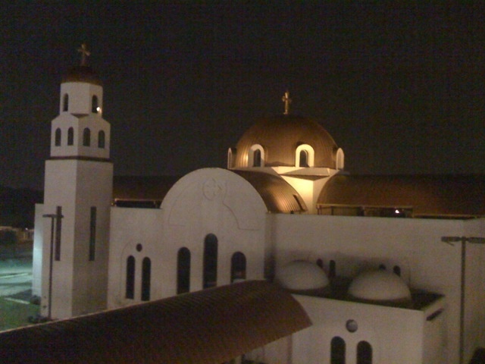
May the blessings of St. Mary , Archangel Michael, all the Saints and all the martyrs be with us all. Amen

